Slide 1







Overview: NIH Multi-Site Protocol Processes
ORSC Protocol Navigator Procedures Workgroup
July 14th, 2022
Jeffrey Rollins BS, CCRP, CIP
sIRB Team Lead, Office of IRB Operations (IRBO)
Shirley Rojas MA (Oxf), MA (Lond), PgDL, LPC, CIP
Reliance Specialist, Office of IRB Operations (IRBO)
Notes:
JR

Slide 2
Fundamentals of single IRB review (sIRB)
Previous OHSRP Education Sessions
What You Need to Know About Single IRB Review: Principles and Practice (Part 1) – July 7, 2020
What You Need to Know About Single IRB Review: Principles and Practice (Part 2) – August 4, 2020
Notes:
JR

Slide 3
Fundamentals of single IRB review (sIRB)
In OHSRP Education presentations, the following topics were covered:
    Defined multi-site research
    Explained sIRB mandates
    Provided an overview of the sIRB review model
    Role and responsibilities of key players
    Development of protocol and consent documents
    Local Context – institutional vs study specific
Notes:
JR

Slide 4
eIRB Systems
With the upcoming eIRB transition from iRIS to the Huron eIRB system, PROTECT, this presentation will not focus on specific iRIS or Huron eIRB processes.
Focus of this presentation will be on multi-site workflows when:
NIH is the reviewing IRB i.e., single IRB (sIRB) for a multi-site study
NIH is a participating site in a multi-site study reviewed by an external IRB serving as the sIRB.
Notes:
JR

Slide 5
Key Terms
TERM | DEFINITION
Core Site | Term used to describe the lead study team. The core site has ultimate responsibility for the conduct and integrity of the research. It usually serves as the main study point of contact for the Reviewing IRB and serves as the conduit for communication to and from the Participating Sites. The core site can also be referred to as the ‘Lead Site’ or ‘Main Site.
Participating Site | A research site involved in multi-site research that relies on the Reviewing IRB to provide oversight for the site. The Participating Site can also be referred to as the ‘pSITE’, ‘local site’, or ‘relying site’.
Relying Institution | An institution participating in multi-site research that cedes IRB review to the Reviewing IRB for human subjects research consistent with the terms of a reliance agreement. The Relying Institution may involve more then one participating study site, e.g., one healthcare system may have multiple hospitals and/or clinics.
Reviewing IRB | The Reviewing IRB will be responsible for reviewing human subjects research and determining that the research meets the required criteria for approval under the regulatory requirements at 45 CFR 46 and, as applicable, 21 CFR 50; 312; 812. When reviewing for a multi-site study, the Reviewing IRB can also be referred to as the ‘single IRB (sIRB),’ ‘IRB of record’ or ‘Central IRB.’
NIH can function as one or a combination of these designations.
Notes:
JR – then introduce SR

Slide 6
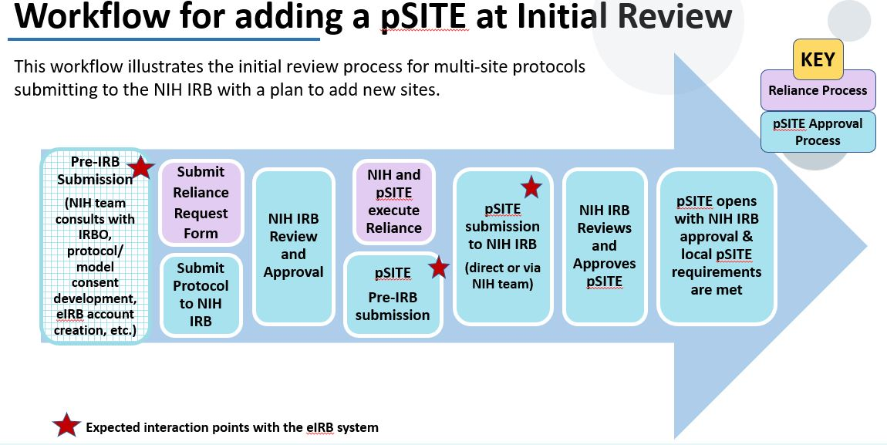
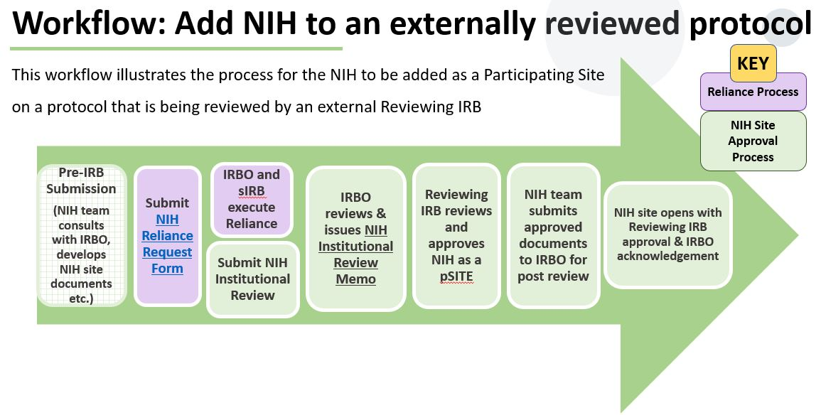
Session Objectives
PART 1: Workflow to add a Participating Site (pSITE) when NIH is the CORE Study Team and Reviewing IRB
PART 2: Workflow for adding NIH as a site on a protocol that is being reviewed by an external Reviewing IRB
Notes:
JR

Slide 7
Session Objectives
PART 1: Workflow to add a Participating Site (pSITE) when NIH is the CORE Study Team and Reviewing IRB
PART 2: Workflow for adding NIH as a site on a protocol that is being reviewed by an external Reviewing IRB
Notes:
JR – Shirley will now cover the submission and implementation of the reliance agreement.

Slide 8
Reliance Agreement
Agreement between two FWA-holding institutions that documents the use of the Reviewing IRB by the Relying Institution
Delineates the institutions responsibilities for sIRB research review
Content is generally consistent, but scope can vary
    Programwide agreements with WCG IRB, Advarra, NCI CIRB
    Master Agreement with SMART IRB
    Regular NIH template for a single protocol
Notes:
SR – reliance agreement is common to part 1 and 2 so before going deep into the workflows we want to discuss, we want to review them,

Slide 9
Reliance Agreement
When NIH is the Reviewing IRB
    The reliance request form should be submitted in parallel to the initial review or, for existing protocols, before the pSITE is added to the protocol
    The reliance needs to be fully executed before any pSITE is added to the NIH protocol
If NIH is relying on external Reviewing IRB
    The reliance request form submission depends on the processes of the external IRB
      If it’s WCG or Advarra IRB, submit when the protocol has been approved
      For others, submit when the protocol is submitted for initial review or has been approved by the external IRB
    Exceptions: NIH is the lead site or the external IRB approves pSITES at initial review
    In general, the Reliance Agreement needs to be executed BEFORE the NIH site can be added to an externally reviewed protocol
Notes:
SR

Slide 10
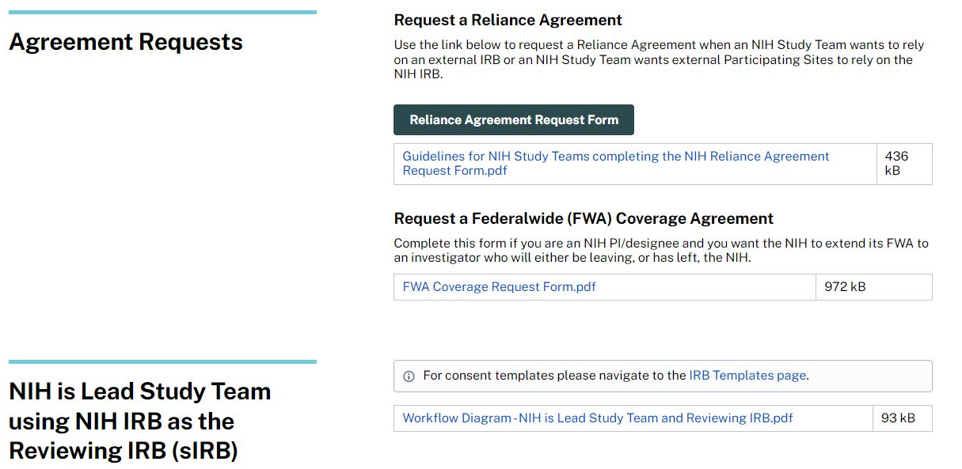
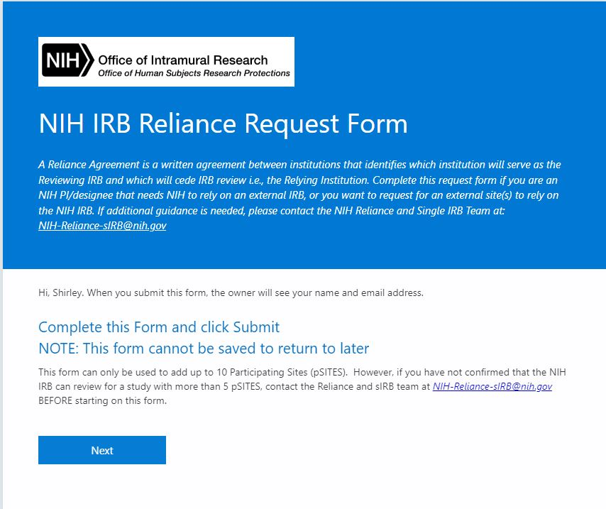
Reliance Agreement
Notes:
SR

Slide 11
SMART IRB Reliance Agreement
SMART IRB is a “Master” reliance agreement not an IRB
Signed by 993 institutions and counting
No additional agreements are required to put the reliance in place
Reliance arrangements still need to be documented on a study-by-study basis
    SMART IRB online reliance platform
    SMART Letter of Authorization
Two versions exist, NIH has signed version 2
NIH is only permitted to rely on, or be relied upon by another v2 signatory
SMART SOPs are followed and, where applicable, NIH IRB SOPs
NIH study teams are advised by IRBO if/ when the online platform is needed
Notes:
SR

Slide 12
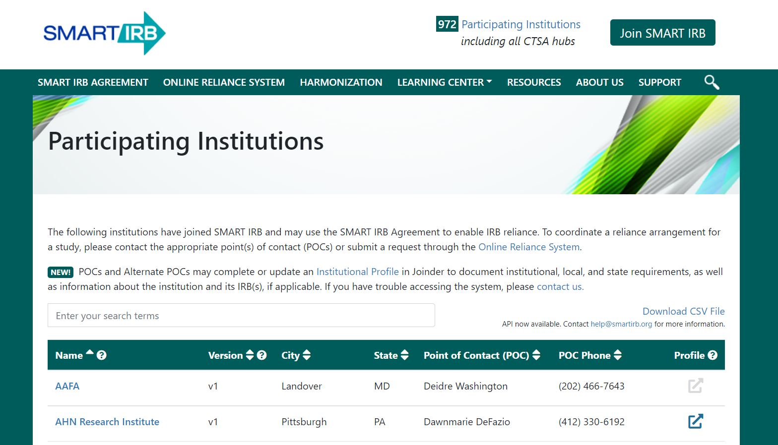
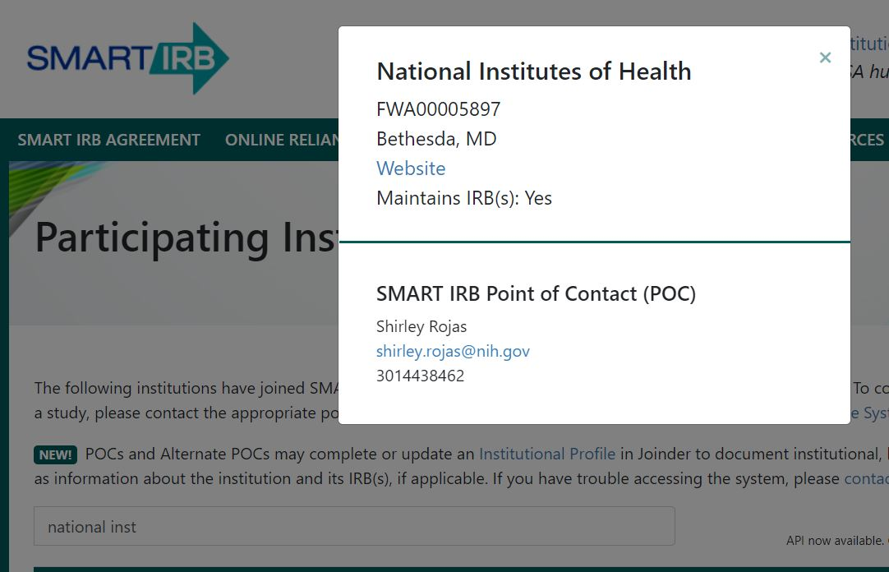
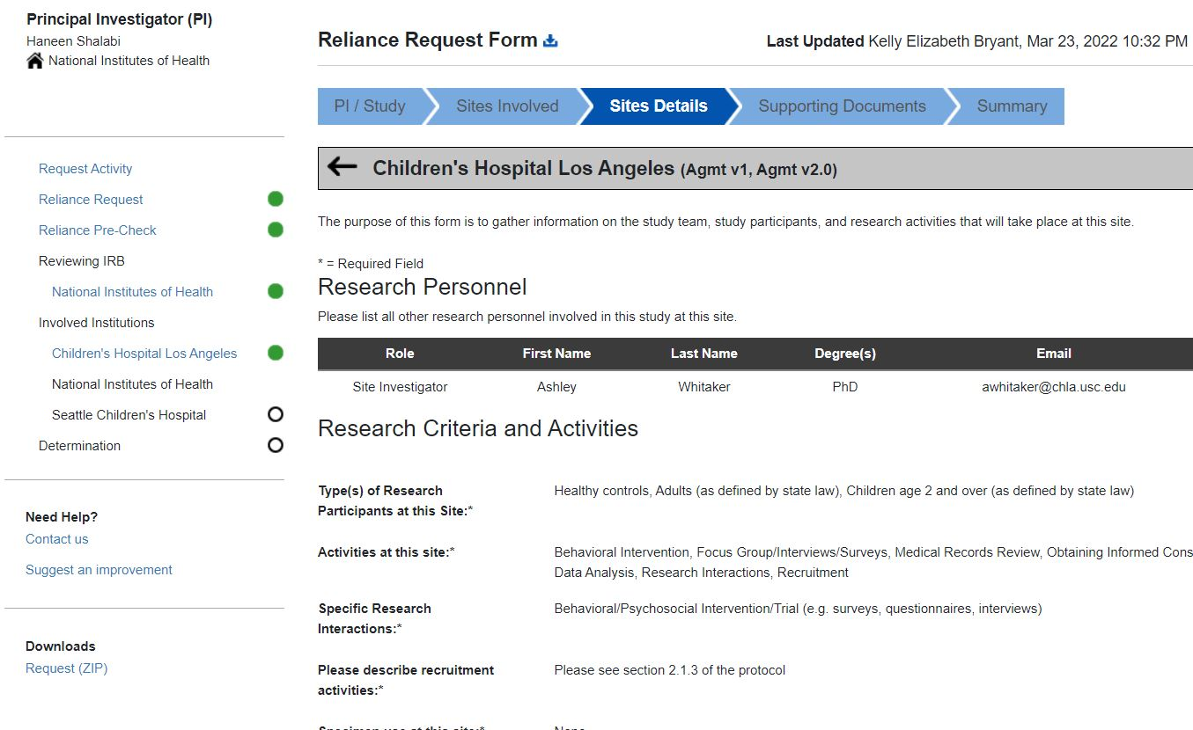
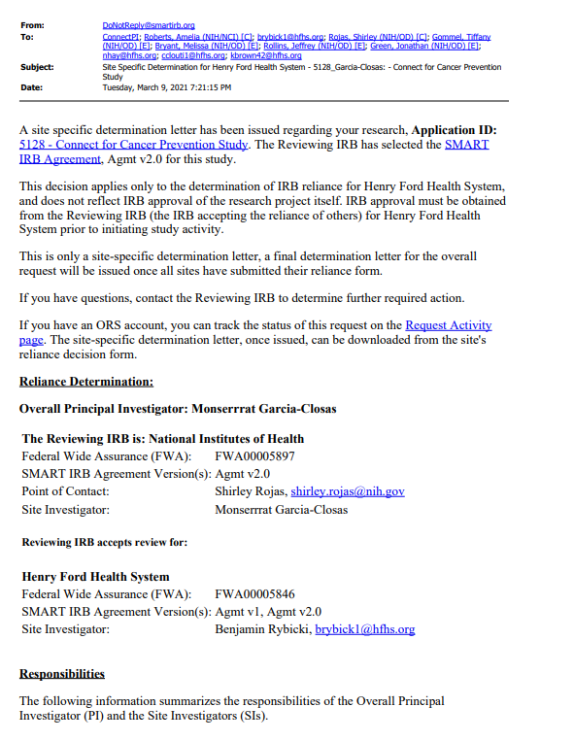
SMART IRB Reliance Agreement
1
SMART resources: https://smartirb.org/
2
3
4
Notes:
SR

Slide 13
Reliance: Reviewing IRB responsibilities
The IRB responsibilities include but are not limited to:
Initial Reviews, Amendments, & Continuing Reviews
Reviews Conflicts of Interest Management Plan Summary,
if applicable
Reviews Reportable Events
IRB-initiated audits/ investigations
Reports to federal agencies and sponsors
Reviews Local Context & Considerations
Reviews and approves pSITE PI
Reviews and approves pSITE materials
This slide is not an exhaustive list of all the clauses in a reliance agreement that relate to the Reviewing IRB. They are focused on what relates most directly to onboarding a pSITE.
Notes:
SR

Slide 14
Reliance: pSITE responsibilities
pSITE responsibilities include but are not limited to:
Providing Local Context
State/ local laws and regulations, institutional requirements, local factors
Providing Documentation/ Assurances
pSITE study team appropriate qualifications & training, local HRPP confirms local context accurate
Notifying Reviewing IRB of reportable events according to NIH IRB policies
Providing pSITE-specific protocol and consent documents, recruitment materials etc.
Provides Conflicts of Interest management plan summary, if applicable
Reviews and approves study personnel
Provides the Reviewing IRB with information about local study conduct that differs from approved protocol
Communicates findings from ancillary reviews that impact risk/ benefit
This slide is not an exhaustive list of all the clauses in a reliance agreement that relate to the pSITE. They focus on what relates most directly to onboarding a pSITE.
Notes:
SR – JR is next slide

Slide 15
PART 1:
Workflow to add a Participating Site when NIH is the CORE Study Team and Reviewing IRB
Notes:
JR

Slide 16

Part 1: Session Objectives
  Reliance Agreement process
  Adding a Participating Site (pSITE) to an NIH protocol
  Review NIH study team (CORE) role and responsibilities
  Review pSITE study team role and responsibilities
Notes:
JR

Slide 17
Workflow for adding a pSITE at Initial Review
KEY
This diagram illustrates the initial review process for NEW multi-site protocols submitting to the NIH IRB with a plan to add new sites.
Pre-IRB Submission
(NIH team consults with IRBO, protocol/ model consent development, eIRB account creation, etc.)
pSITE submission to NIH IRB
(direct or Amendmentvia NIH team)
NIH IRB Reviews and Approves pSITE
Submit Protocol to NIH IRB
NIH IRB Review and Approval
pSITE
Pre-IRB submission
NIH and pSITE Execute Reliance
pSITE opens with NIH IRB approval & local pSITE requirements are met
Reliance Process
pSITE Approval Process
Submit Reliance Request Form
Expected interaction points pSITEs will have with the eIRB system
Notes:
JR Using the multisite module

Slide 18
Workflow for adding a pSITE for an on-going study
This diagram illustrates the process for an ACTIVE/ OPEN study needing to become multi-site or add new sites to an existing multi-site study.
Existing studies function under one of two scenarios:
KEY
Pre-IRB Submission
(NIH team consults with IRBO, protocol/ model consent development, eIRB account creation, etc.)
pSITE submission to NIH IRB
(direct or Amendment via NIH team)
NIH IRB Reviews and Approves pSITE
Submit Amendment to NIH IRB
NIH IRB Review and Approval
pSITE Pre-IRB submission
NIH and pSITE execute Reliance
pSITE opens with NIH IRB approval & local pSITE requirements are met
Reliance Process
Legacy approach
Converted to the MS module
pSITE Approval Process
Submit Reliance Request Form
Expected interaction points pSITEs will have with the eIRB system
- - Dashed line means this step is not always required. Its need is determined by the protocol and planned collaboration.
Notes:
JR – Dashed line means the step may not be required, based on protocol and planned collaboration – in consultation with sIRB/reliance team.
May or may not use multi-site module – Submit AM to NIH IRB currently used at this point to convert a single site study to the multi-site module
NIH IRB Review and Approval: This stage would not be applicable if the multi-site module isn’t being used. This only applies to the Amendment converting to the MM module
pSITE submission to NIH IRB: this will happen directly from the site using the multisite module and via the NIH study team in the legacy instance via a regular AM form. This could be different under Huron.
a site working on data only, unlikely will be asked to convert to multi-site.

Slide 19
Workflow for adding a pSITE at Initial Review
KEY
Pre-IRB Submission
(NIH team consults with IRBO, protocol/ model consent development, eIRB account creation, etc.)
pSITE submission to NIH IRB
(direct or Amendment via NIH team)
NIH IRB Reviews and Approves pSITE
Submit Protocol to NIH IRB
NIH IRB Review and Approval
pSITE
Pre-IRB submission
NIH and pSITE execute Reliance
pSITE opens with NIH IRB approval & local pSITE requirements are met
Considerations for the NIH Team
Reliance Process
pSITE Approval Process
Submit Reliance Request Form
NIH Team and pSITE work together to prepare submission to NIH IRB
Expected interaction points pSITEs will have with the eIRB system
Notes:
JR

Slide 20
Role of NIH PI and NIH Study Team
NIH PI assumes leadership and has ultimate responsibility for conduct of the research study
Leads the development of the protocol, model consent documents, model recruitment materials, study instruments
Ensures study coordination, communication, and routing of IRB submissions (in collaboration with Reviewing IRB)
Verifies that pSITES have approved protocol and model study materials (consent/ recruitment template) and ensure they understand what sections can be revised during the development of their documents
Ensures study teams are aware of NIH IRB policies and procedures
Facilitates submissions to the NIH IRB for all pSITES
Provides information to the NIH IRB at the time of continuing review about the study’s progress and conduct
Ensures IRB-approved materials/determinations are provided to all pSITE study teams
Notes:
JR

Slide 21
NIH Study Team, pSITEs, and NIH IRB Communication
Legacy approach
All study information flows to the NIH IRB through the NIH study team; pSITE PIs send information to NIH PI/ designee for processing
No direct communication between pSITE team and NIH IRB
eIRB model utilizing multi-site functionality
Study-wide information can more easily flow between the NIH IRB, the NIH study team, and pSITE team(s)
pSITE study information submitted directly to the NIH IRB via the pSITE study team; NIH PI/ designee serves as a gatekeeper (current eIRB model) –
  Opportunity for the NIH study team to vet submission before it reaches NIH IRB
Still need to maintain good communication between NIH study team and pSITEs
Notes:
JR

Slide 22
Communication Plan
Keep in mind that the way NIH PI/ Lead Site and pSITEs communicate differs when using an eIRB multi-site system vs the Legacy Module
  Presents different challenges
  Consider differences when developing/ executing a communication plan
  Do not rely solely on the eIRB system to facilitate communication across sites
  Suggest NIH Study team have regular communication with the pSITEs
    Site initiation meetings; regular conference calls; newsletter; email blasts; training materials
Can work in collaboration with the NIH IRB to determine best plan for communicating and coordinating information to pSITEs
Notes:
JR

Slide 23
Protocol - NIH PI/Study Team Responsibilities
Study-wide protocol should be written in a way that incorporates all human subjects research activities; not only NIH specific
  List the number of sites involved in the protocol
    Do not list the name of each site or the pSITE PI
      this is currently listed in the iRIS study application
  Include all potential subject types e.g., if only one site is enrolling children, the protocol still needs to list this population
  Number of subjects to be recruited from each pSITE, if not competitive enrollment
  Recruitment and Screening Procedures
  Compensation plan
  Multi-site safety monitoring coordination plan
  Refer to NIH Protocol Template for other guidelines regarding multi-site protocols
Notes:
JR

Slide 24
Model Recruitment Forms - Lead PI/Study Team Responsibilities
Model recruitment materials are created if they will be used at more than one site.
  IRB approval is not required at the pSITE level if pSITE changes consist only of inserting institutional logos and/or contact information e.g., phone number; email address; contact name
  These changes can be made administratively by the pSITE without IRB review/approval
    Any other changes at the pSITE level would require IRB review/approval
  NIH IRB suggests NO other changes to model recruitment material at the pSITE level unless warranted by policy at that institution
Some pSITEs may have specific site recruitment materials that will be used only at that site. Submit to the NIH IRB for approval with the pSITE application
Notes:
JR

Slide 25
Model Consent Forms - Lead PI/Study Team Responsibilities
Responsible for the creation of the Model Consent/ Assent forms (in addition to the NIH site specific versions)
  Use the Model Consent Template on the IRBO website
    Some sections will apply to all sites, other sections will need modifications
    Not one size fits all – there can be exceptions
      Costs, compensation, and/or reimbursement sections could be different
      COI (if a conflict exists), research related injury language, who to contact in case of complaint would mostly likely be different
      Anything specific at the site should be added e.g., if a scan or survey will only take place at the site or is different in some way
Assent process may be different at each institution, anticipate differences e.g., signature requirements may be different
Notes:
JR

Slide 26
Coordinating Center
Not one definitive definition of a Coordinating Center
The term ‘Coordinating Center’ can cover several very different research-related activities
  Can be the NIH PI/Lead Site or delegated to another entity
  Some only handle data center functions
  Some have study-wide responsibilities of most or all aspects of the multi-site protocol e.g., consent form development, coordinate data collection, create and manage the overall operations of a study
  Contract and/or grant should outline scope of work to outline Coordinating Center activities and those of the pSITE(s)
  Coordinating Center functions need to be clearly described in the protocol
Notes:
JR

Slide 27
Coordinating Center cont’d
Possible Coordinating Center Responsibilities (not inclusive)
  Develop the protocol, model consent documents, model recruitment materials, study instruments
  Conduct data and/or statistical analysis
  Lead communication efforts across all pSITEs to include current enrollment numbers, study progression, upcoming revisions
  Ensure pSITEs are receiving IRB correspondence and notification of Amendments, Progress Reports, etc. (Legacy vs eIRB multi-site module approach needs to be considered, especially during the eIRB transition)
    Coordinating Center or NIH PI/ Lead Site is responsible for ensuring distribution of study-wide documents to the pSITEs
  Overseeing data transmissions amongst sites
Notes:
JR

Slide 28
Workflow for adding a pSITE at Initial Review
KEY
Pre-IRB Submission
(NIH team consults with IRBO, protocol/ model consent development, eIRB account creation, etc.)
pSITE submission to NIH IRB
(direct or via NIH team)
NIH IRB Reviews and Approves pSITE
Submit Protocol to NIH IRB
NIH IRB Review and Approval
pSITE
Pre-IRB submission
NIH and pSITE execute Reliance
pSITE opens with NIH IRB approval & local pSITE requirements are met
Considerations for the pSITE
Reliance Process
pSITE Approval Process
Submit Reliance Request Form
Expected interaction points pSITEs will have with the eIRB system
Notes:
JR – introduce SR

Slide 29
Role of pSITE Study Team
Responsible for conduct of the research at the pSITE
Follow NIH IRB policies and procedures (e.g., for reportable events, personnel changes) and applicable pSITE requirements
Use NIH IRB approved materials including the consent form template (except for locally required language that can be added/ changed)
Work with pSITE HRPP/IRB to ensure that appropriate local context information is provided to the NIH IRB
Provide NIH Study Team with pSITE information when initially being added, on study progress for continuing review, and local problem events so that they can be reported to the NIH IRB
    Via eIRB system and/ or with supporting documents ( protocol addendum and site consents)
Notes:
SR

Slide 30
Current pSITE submission
- pSITE Application - If using the multi-site module in iRIS
pSITE Protocol Addendum – A legacy and multi-site module version exists
- pSITE Consent(s)/ Assent(s) - Approved model templates plus pSITE edits
- Recruitment materials - Only when changes go beyond fillable fields in model recruitment materials
- pSITE HRPP/ IRB “Cede Letter” - Per NIH Policy 105: Notification indicating institutional requirements have been met and local context information approved by the pSITE institution e.g., letter, email, memo etc.
Other Supporting Materials –
Notes:
SR

Slide 31
Content of a pSITE submission
Initial Review approves the research protocol and NIH Site
Baseline assumption for the pSITES will therefore be based on how the research is described in the protocol and how it will be implemented at the NIH
Focus for the pSITE submission is to:
    Provide the NIH IRB pertinent pSITE information to provide oversight
    Have the pSITE’s implementation of the protocol approved
The pSITE submission therefore needs to describe
    Pertinent local context information about the pSITE
    When the pSITE will:
        Not implement the research in the way described, or
        Implement it in a different way, or
        Do something in addition to what is approved in the protocol
Notes:
SR

Slide 32
Content of a pSITE submission
Study Procedures
Medical records review, obtaining informed consent, research interactions, recruitment etc.
Description needed if recruitment activities will differ from the protocol
Recruitment
Billing of insurance, local rates of compensation, and availability of reimbursement
Costs, Compensation & Reimbursement
Use of NIH / local short forms, assent, waivers of consent, e-consent, management of consent process when subjects lack decision-making capacity etc.
Consent Process and Forms
Data/ Specimens Use & Storage
Data: Analysis, banking, creation of repository
Specimen: anonymous, coded/ deidentified etc.
Centrally vs locally stored, local security measures, duration of storage, etc.
Notes:
SR

Slide 33
Content of a pSITE submission
Adults, Children, Employees, Students, Adults lacking decision-making capacity etc.
Types of research subject
Regulatory, local, and institutional requirements age of majority, who can obtain consent, required state reporting etc.
Local Context
Ancillary Reviews
Conflicts of Interest, Pharmacy, Radiation Safety, Biostatistics, Nursing etc. Verify completion but should also be used to provide rationale for protocol/ consent edits
Conflict of Interest
Whether investigator has a financial interest and, if so, provide summary
Study team qualifications & HRPP training
pSITE confirm that study team are qualified and have completed HRPP training
Notes:
SR

Slide 34
pSITE Consent Documents
Typically developed from the NIH Model Consent
The NIH Model Consent(s) has sections that are the same for each site and sections that allow customization by the pSITE to address local context
pSITE study team should work with the pSITE HRPP/ IRB to identify institutional language that needs to be included in the pSITE consent
Suggested changes should be substantiated:
    The way the protocol will be implemented at the pSITE
    State and local laws, or institutional policies and procedures
Exceptions: Some pSITEs may have a site specific ICF e.g., only a survey is taking place at that site (no need for a model ICF in this case)
pSITE HRPP/IRB may issue confirmation that consent is appropriate
Notes:
SR – If subjects being seen at another site then a consent is needed. Not usually the case that a subject seen at the NIH and can go to another site without a different consent.

Slide 35
Mandatory sections in pSITE Consent Documents
Aside from regulatory-required language, structure (e.g., key information etc.) and study procedures, the following should be in the pSITE consent:
  Certificate of Confidentiality
        Cannot be removed from a domestic pSITE
  Privacy Act text
        When identifiable information will be sent to the NIH
  Standard language about clinicaltrials.gov
  The NIH IRB identified as the Reviewing IRB and with contact details
Notes:
SR

Slide 36
Flexibilities in the pSITE Consent Documents
NIH IRB permitted changes include but are not limited to:
  Header/Footer – provided there is space for the NIH IRB stamp
  pSITE PI and study team contact information
  The inclusion of references to the pSITE
  Compensation, Costs, and Reimbursement
  Conflicts of Interest
  Radiation Safety language
    A local ancillary review that may generate a need to amend the protocol and/ or consent form as it alters the risk/benefit analysis
    NIH model text can be added to by the pSITE.
    Rationale needed if it is to be deleted e.g., no radiation use at pSITE
  GINA language: Some states mandate use of specific language
Notes:
SR

Slide 37
Flexibilities in the pSITE Consent Documents
Confidentiality language
    May be replaced or augmented provided consistent with how data/ samples will be managed study-wide
Subject complaints
    pSITE HRPP/IRB office contact information can be added
Study procedures can be deleted, changed, or added to when the pSITE is implementing the protocol differently
Use and storage of data/ samples may be altered
Research-related injury language & statement about available medical treatment
Assent process
    pSITES will have different processes (e.g., documenting assent via signature not research record); need to anticipate the impact of those differences
Notes:
SR

Slide 38
HIPAA in pSITE Consent Documents
The NIH’s position is that:
      NIH is not a covered entity and
      NIH IRB will not serve as a privacy board
pSITEs therefore need to address their own HIPAA obligations locally
NIH IRB prefers HIPAA is dealt with in a stand-alone form which does not need to be provided to the NIH IRB
However, a pSITE consent form that is combined with a HIPAA authorization is permitted. The NIH IRB will only review the consent portion.
Notes:
SR – introduce JR

Slide 39
pSITE Approval
When can a pSITE begin Human Subjects Research (HSR) activities?
Reminder that Participating Sites are reviewed and approved after the NIH Site is approved
From the IRB’s perspective, once a site has full IRB approval, HSR activities can begin
However, the pSITE must ensure that all local reviews/ approvals required by its institution are in place
  Examples of other reviews that may be required are coverage analysis, specific department approvals, data use agreements, material transfer agreements, ancillary committee reviews (e.g., radiology, nursing, and pharmacy)
    Communicate with the pSITEs so expectations on when they can begin research activities are established
Notes:
JR

Slide 40
Top Tips: Adding a pSITE to an NIH protocol
  Establish effective communication pathways
  Is the pSITE a SMART signatory?
  Ask the pSITE to find out what is required from them by their HRPP/ IRB in order to rely on an external IRB
  Does a model consent need to be developed?
  Provide the pSITE with guidance to develop the pSITE consent
  Try to limit customization of documents at the pSITE level e.g., recruitment materials
Notes:
JR

Slide 41
Part 1: Session Objectives
  Reliance Agreement process
  Adding a Participating Site (pSITE) to an NIH protocol
  Review NIH study team (CORE) role and responsibilities
  Review pSITE study team role and responsibilities
Notes:
JR

Slide 42
PART 2:
Workflow: Adding NIH as a site on a protocol that is being reviewed by an external Reviewing IRB
Notes:
JR

Slide 43

Part 2: Session Objectives
  Reliance Agreement process
  Review principles of relying on an external IRB
  Review NIH study team role and responsibilities
  Preparing a submission for an NIH Institutional Review
Notes:
JR

Slide 44
Workflow: Add NIH to an externally reviewed protocol
This diagram illustrates the process for the NIH to be added as a Participating Site
on a protocol that is being reviewed by an external Reviewing IRB
KEY
IRBO reviews & issues NIH Institutional Review Memo
Reviewing IRB reviews and approves NIH as a pSITE
Submit NIH Institutional Review
IRBO and sIRB execute Reliance
NIH team submits approved documents to IRBO for Post Review
Submit NIH Reliance Request Form
NIH site opens with Reviewing IRB approval & IRBO acknowledgement
Pre-IRB Submission
(NIH team consults with IRBO, develops NIH site documents etc.)
Reliance Process
NIH Site Approval Process
IRBO’s role in this process is administrative;
the NIH institutional review does not constitute an IRB review/ approval
Notes:
JR

Slide 45
Workflow: Add NIH to an externally reviewed protocol
TWO STEP PROCESS
KEY
IRBO reviews & issues NIH Institutional Review Memo
Reviewing IRB reviews and approves NIH as a pSITE
Submit NIH Institutional Review
IRBO and sIRB execute Reliance
NIH team submits approved documents to IRBO for Post Review
Submit NIH Reliance Request Form
NIH site opens with Reviewing IRB approval & IRBO acknowledgement
Pre-IRB Submission
(NIH team consults with IRBO, develops NIH site documents etc.)
Request a Reliance Agreement
Reliance Process
2. Complete the NIH Institutional Review process (pre and post external IRB review)
NIH Site Approval Process
RESULT: NIH gets added as a Participating Site to the Protocol reviewed by the external Reviewing IRB
Notes:
JR

Slide 46
Workflow: Add NIH to an externally reviewed protocol
TWO STEP PROCESS
KEY
IRBO reviews & issues NIH Institutional Review Memo
Reviewing IRB reviews and approves NIH as a pSITE
Submit NIH Institutional Review
IRBO and sIRB execute Reliance
NIH team submits approved documents to IRBO for Post Review
Submit NIH Reliance Request Form
NIH site opens with Reviewing IRB approval & IRBO acknowledgement
Pre-IRB Submission
(NIH team consults with IRBO, develops NIH site documents etc.)
Request a Reliance Agreement
Reliance Process
2. Complete NIH Institutional Review process (pre and post review)
NIH Site Approval Process
NIH Study Team and IRBO work together to finalize NIH site documents before submission to external Reviewing IRB
Notes:
JR – remind that reliance has been covered and concepts are similar

Slide 47
Principles of Relying on an external Reviewing IRB
NIH is not the Reviewing IRB and has ceded IRB review to an external IRB
  The institutional review by IRBO is not a review by the NIH IRB
NIH retains responsibilities as an FWA-holding institution e.g., training & qualifications, resources, ancillary reviews etc.
IRBO’s administrative reviews and the maintenance of a shadow protocol is the main mechanism used by the NIH to address these responsibilities
    Ensures NIH study teams are also compliant with NIH requirements
Reviewing IRB approves the NIH site, NIH IRBO acknowledges the approval
NIH Site can commence research activities once it has
    Approval from the Reviewing IRB and
    Completed the NIH Institutional Review process
Notes:
JR

Slide 48
Role of NIH Study Team
Responsible for conduct of the research at the NIH
Follow the reviewing IRB’s policies and procedures (e.g., for reportable events, personnel changes) and applicable NIH HRPP requirements
  Note that there are dual reporting requirements
Use Reviewing IRB approved materials including the consent form template (adding/ changing appropriate locally required language)
Complete all applicable NIH ancillary reviews
Submit documents for NIH Institutional Review
Work with NIH IRBO to ensure that appropriate local context information is provided to the Reviewing IRB when initially being added as a site
Notes:
JR – introduce SR

Slide 49


NIH Institutional Review Submission
NIH Study Team
(Participating Site Study Team)
NIH IRBO (Relying Institution)
Once completed, IRBO issues:
NIH Institutional Review Memo
PLUS a Stipulation
Confirms that submission meets NIH institutional requirements
Serves as “green light” to NIH Study Team that can move forward and submit to Reviewing IRB
If required, provides additional guidance on submission
Provide to Reviewing IRB
Submits in eIRB system:
Model Consent(s)/Assent(s)*
NIH Protocol Addendum
NIH Consent(s)/Assent(s)
Study Personnel Page
Ancillary Reviews e.g., DEC, RSC, Scientific Review, IBC, PRIA etc.
Recruitment Materials, if unique
Investigator Brochure
Conducts Institutional Review
Ensures NIH Protocol Addendum meets NIH requirements
Confirms NIH required language in consent/ assent documents
Verifies Ancillary Reviews
Checks HRPP Training Records
* If NIH is the lead site
Notes:
SR

Slide 50
NIH Protocol Addendum
Describe NIH’s proposed role in the research and applicable institutional requirements
Ensures that Reviewing IRB understands protocol implementation at the NIH
Supplements the Main Protocol Document and must be read in conjunction with it
  Expands on protocol content by:
    Correcting statements that something will be done at the NIH site when it won’t and/or
    Describes when NIH will do something differently/ in addition to the protocol
Avoid defaulting to language that is submitted when NIH is the reviewing IRB
Should not duplicate the protocol
Distinct from NIH Protocol Supplements developed when the NIH is going to be implementing a Sponsor Protocol and the NIH is the Reviewing IRB.
    These supplements tend to be more comprehensive documents as they need to satisfy all NIH HRPP and IRB requirements
Notes:
SR

Slide 51
NIH Protocol Addendum – Examples of Typical Content
Institutional and Operational Requirements:
  Adding NIH IRB# and identifying involved NIH sites, especially when go beyond the NIH CC
  NIH not subject to state law, will not bill insurance, and primarily a research facility
  NIH study team will report events to OHSRP in addition to reporting to the Reviewing IRB
Protocol Implementation:
  Describing ways in which screening, recruitment, compensation, reimbursement, or procedures will be conducted differently, or not at all, at the NIH, such as:
      NIH will enroll a specific cohort
      Data in CRIS will go to BTRIS
Consent Implementation:
  Assent process for children e.g., format, variation by age group, documentation method etc.
  Determining subject capacity and adherence to NIH HRPP Policy 403
  Enrolment of non-English speakers and use of NIH short form consent
  Re-consenting of subjects who reach 18 and requesting waiver of consent
  Varying consent process to fit the NIH context e.g., documenting assent on research record not consent form, e-consent method etc.
NIH will perform an extra scan and questionnaire
Not permit sponsor GDPR language
Notes:
SR

Slide 52
NIH Consent/ Assent
Developed from the Reviewing IRB-approved “Model Consent/Assent”
NIH study team needs to customize to include NIH institutional requirements and communicate how the protocol is going to be implemented at the NIH
Usually involves inserting NIH language into the Model Consent with NIH edits tracked. Do not initiate using NIH template.
Acceptable to retain language from the Model Consent when equivalent to NIH template language
    Exceptions e.g., research-related injury, Certificate of Confidentiality etc.
Needs to be consistent with the NIH Protocol Addendum
Evolving craft where still learning what are true non-negotiables and need to be flexible as external IRBs take different approaches e.g., using 2-part consents
Where possible, prudent to establish what are the acceptable parameters for the Sponsor, the Reviewing IRB, NIH, and/or the Lead Study Team
Notes:
SR

Slide 53
NIH Site Consent – Examples of Typical Customization
Additions:
NIH IRB number
NIH CC header and footer, including consent #
Compensation & reimbursement text
NIH research-related injury language
Certificate of Confidentiality and Privacy Act language
Appropriate sections of the NIH signature block
Key Information section and revised Common Rule elements
Deletions:
HIPAA-related text
Assertions that insurance will be billed
Assertions that subjects can continue clinical care at the NIH if withdraw from study
References that combine Sponsor and Study Site conduct or responsibilities
Notes:
SR

Slide 54
Additional Requirements by the Reviewing IRB
Reviewing IRB can impose additional requirements on the NIH:
    Method by which they want to receive the protocol and/ or local context submission by the NIH study team i.e., via a conduit (lead study team, coordinating center etc.), directly using their eIRB system, via a third-party website (iREX) etc.
    Sequence for submission may not align with NIH’s workflow
      Reliance is executed when NIH is added as a site or request local context information when reliance is executed. Discuss with IRBO to try to sync up processes.
Request Local Context information in a stand-alone local context form or institutional profile
    Reviewing IRB is trying to understand applicable NIH policies, local norms, special requirements, culture, etc. in order to conduct its review
    Usually comprises of information specific to NIH as the Relying Institution AND study-specific information relating to how the protocol will be implemented at the NIH site
    Identifying pertinent local context is a collaborative effort between NIH Study Team and IRBO
    NIH IRBO needs to ultimately sign off on information provided
    Additional forms should be submitted by email to IRBO at the time of NIH Institutional Review
Notes:
SR

Slide 55
Approval and Activation of NIH as Participating Site
Submission to Reviewing IRB
NIH Study Team submits to the Reviewing IRB requesting to be added as a site to the protocol
NIH Protocol Addendum and Consent/ Assent documents should be the last version seen by IRBO
Once NIH is approved as a site by the Reviewing IRB, the NIH Study Team must submit the approved protocol and consent documents, and corresponding IRB approval back to NIH IRBO
IRBO Activation Review “Post-Review”
NIH Study Team submits a “Response Review Submission Form” in response to the single stipulation issued at the time of the NIH Institutional Review Memo
Clean version of documents should be submitted unless the Reviewing IRB has made changes
IRBO reviews the documents to ensure remain consistent with NIH institutional requirements
  Captures pertinent information e.g., risk determination for a specific population, CR date etc.
  Activates NIH Site according to Initial Review Form study status e.g., “Open – Recruiting”
  Acknowledges the NIH is approved as a site and all approved documents
If at the NIH Clinical Center, documents forwarded to Office of Protocol Services for processing
Notes:
SR

Slide 56
Shadow Protocol: NIH Relying on External Reviewing IRB
Maintain Shadow Protocol in eIRB system
    Currently approved protocol, consent and assent documents
    Consent/ assent must be Reviewing IRB-approved version
Each study lifecycle action must be submitted e.g., amendment, continuing review
  No batch submissions
External IRB determination/approval letter must be included with submissions
If External IRB does not approve research personnel, NIH study personnel changes are submitted to IRBO for review
Close study via Progress Report Form
Notes:
SR

Slide 57
Top Tips: Add NIH to an externally reviewed protocol
  Has the study been reviewed under the revised Common Rule?
  What is the sequence of the reliance being documented vs the submission to add NIH as a site?
  How does the Reviewing IRB want the consent forms managed – NIH site consent only or in 2 parts?
  Will additional local context information be requested?
  How does the Reviewing IRB want to receive the NIH’s submission?
Notes:
SR

Slide 58
Part 2: Session Objectives
  Reliance Agreement process
  Review principles of relying on an external IRB
  Review NIH study team role and responsibilities
  Preparing a submission for an NIH Institutional Review
Notes:
SR

Slide 59
Contact Us
NIH IRB Reliance & sIRB Team
For further guidance or questions:
Web: Reliance and sIRB IRBO webpage
Multi-Site Research (nih.gov)
Email: NIH-Reliance-sIRB@nih.gov
Notes:
SR

Slide 60
Questions?
Notes:
SR

