Slide 1
Tips & Tricks: Document Management
Presented by:
Protect Training TEAM

Slide 2
Agenda
Document Management Topics:
  Stacking documents when changes are made (MODs)/ modifications required
  Comparing documents in the system
  Where/how to find most recently approved documents
  Where and how to attach documents
  Scenarios to fix stacking of documents
  How to properly name your documents
  Document formats that PROTECT allows
  Demo?
  Q&A

Slide 3
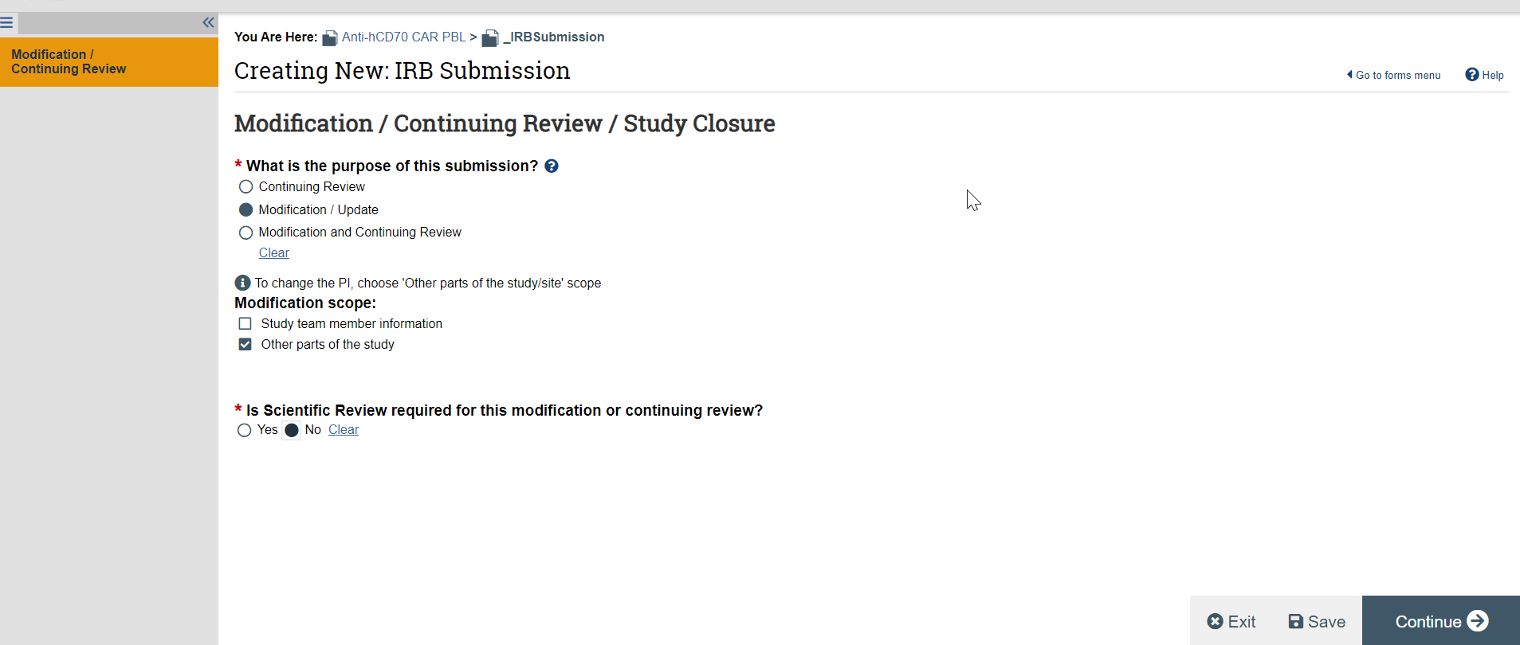
Stacking Documents for MODs
You will update your documents by using your MOD form and updating them directly from the form

Slide 4

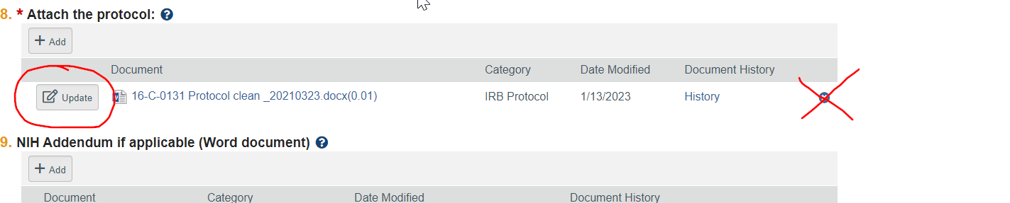
Stacking Documents for MODs
In PROTECT, to update documents we edit the main study form located within the MOD form
When updating an already existing document with a MOD ALWAYS click the “update” button next to the document in the form. NEVER click the delete (x) icon unless advised to do so (scenarios described later) and with our help.
Clicking the delete icon will delete the whole history of documents underneath each file and they cannot be used to compare changes to documents.

Slide 5
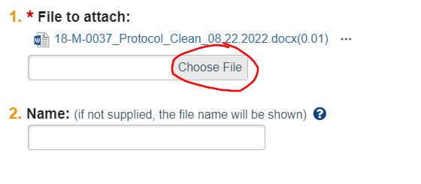
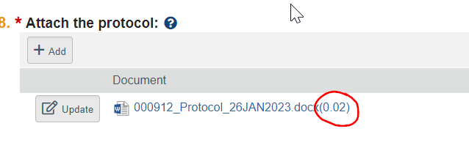
Stacking Documents for MODs
After clicking “update” you will get a pop-up screen allowing you to choose a file to upload on top of the current document.
Click the “choose file” button which will open the folders on your computer to allow you to choose a document.
You will see the name of the document appear with its file name. Below you will see a text box for you to type in a name. If you leave this blank it defaults to the file’s current name or you can type in a new name for the file. You will see the document version number increase as you stack more documents. (i.e. 0.01, 0.02, 0.03)

Slide 6
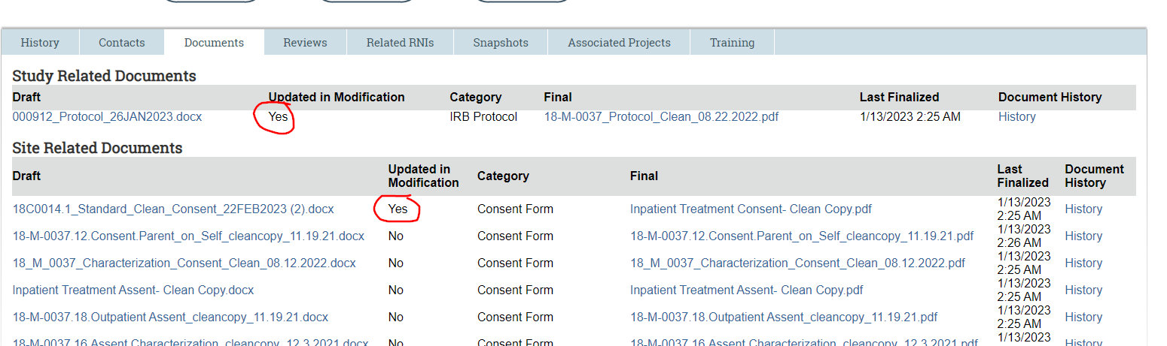
Stacking Documents for MODs
Once you have completed your form, under your “documents” tab the documents that were updated with your MOD form with have a “Yes” next to them to easily identify which items were changed with your MOD.

Slide 7
Stacking Documents for MODs
***Be very careful when uploading documents in PROTECT.
Try not to upload your documents until you have the absolute final clean copy and are ready to submit.
Any updates you make to the uploaded document before submitting will create a new version.
There is no way to delete any version you created in the submission form. The only option is to delete the whole document history for that file.
If you need to make another revision, you need to upload a new version on top of the existing document.

Slide 8
Revising documents when modifications/clarifications are required
When a submission is sent back for clarifications or modifications required to secure approval and documents need to be revised:
You will first need to edit the form by clicking “edit modification/CR, edit study etc.” button.
You will then stack your modified clean document with your revisions on top of the previously uploaded document.

Slide 9
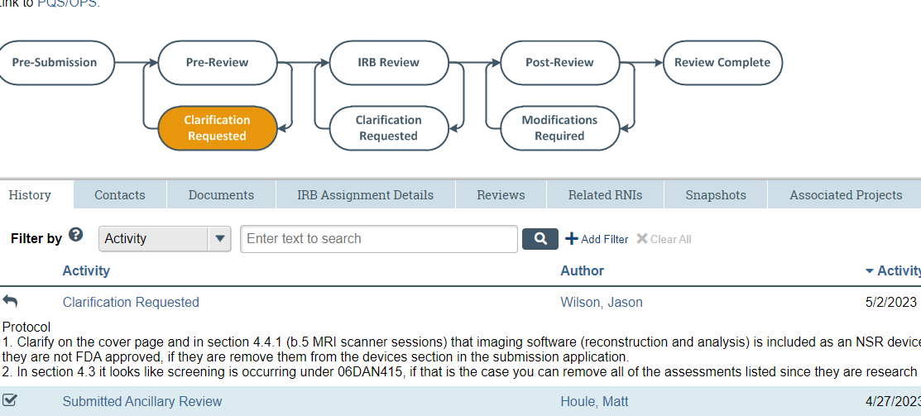
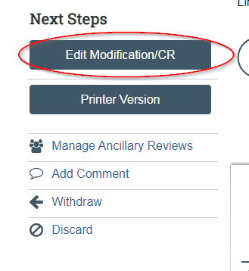
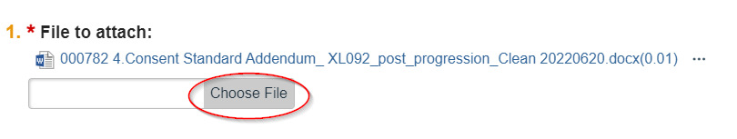

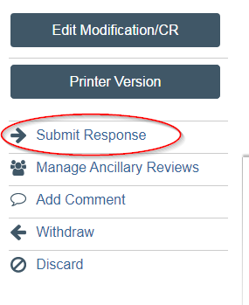
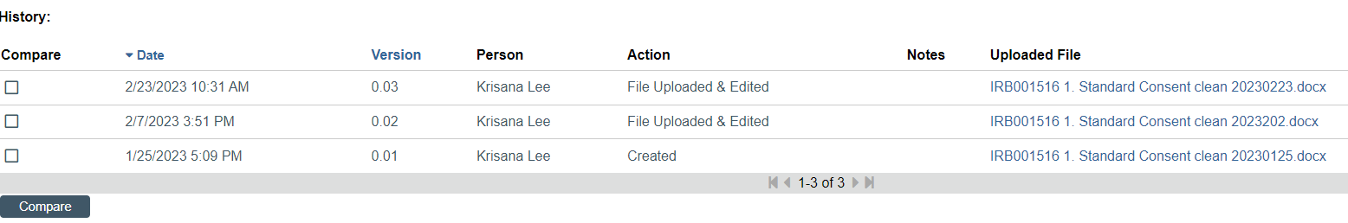
Clarification Received
Edit Study Form
Update Document
New Version Created to Compare
Submit Response
Sends it back to the IRB

Slide 10
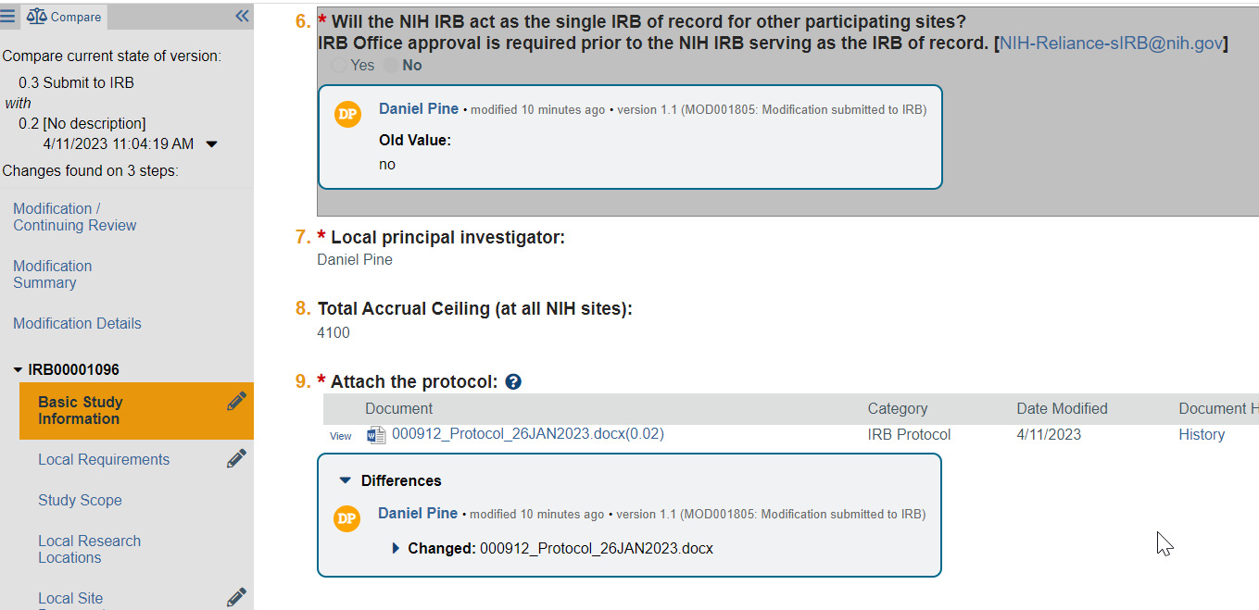
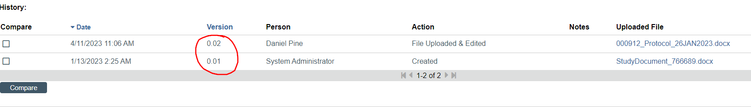
Comparing Documents in PROTECT
If you are reviewing a Modification you can use the compare feature within the MOD form to see what documents have been changed.
You can also click the blue History button next to the document and it will take you to a screen that shows all the versions of that document. You will notice the incremental changes in the version numbers:

Slide 11
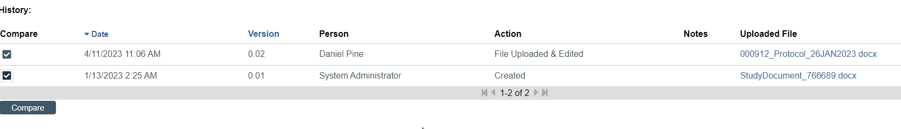
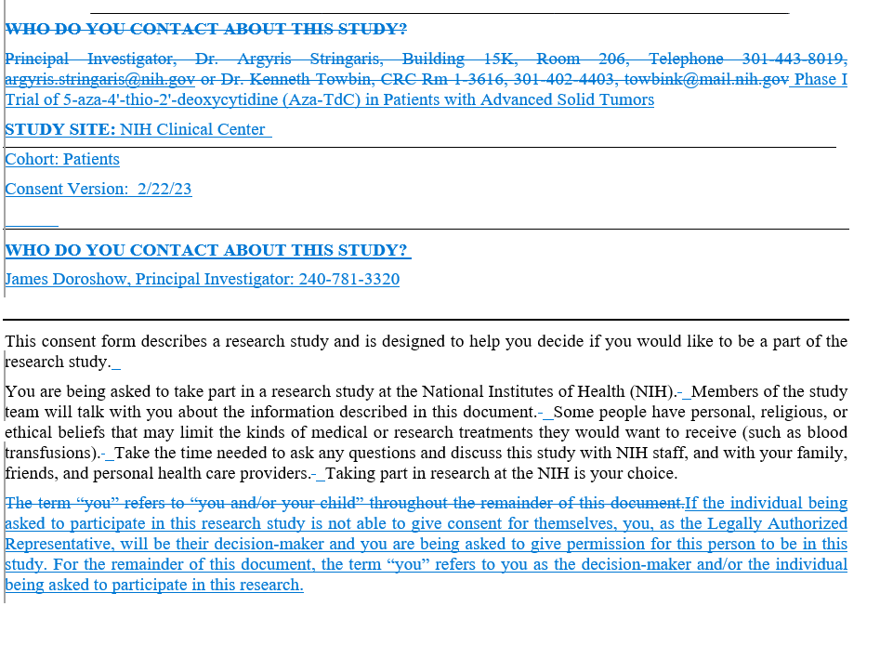
Comparing Documents in PROTECT
In order to view the changes made within the new document, you will use the compare function in PROTECT. This will then open a Word document with tracked changes showing the changes made.
NOTE: this is how the IRB is comparing documents in PROTECT. NEVER upload tracked changed documents unless advised to do so. Also do not upload PDF versions of the consent or the NIH protcol. PROTECT cannot compare PDFs, it can only compare two WORD documents.
Do not convert PDF consents to Word as this often creates formatting errors

Slide 12
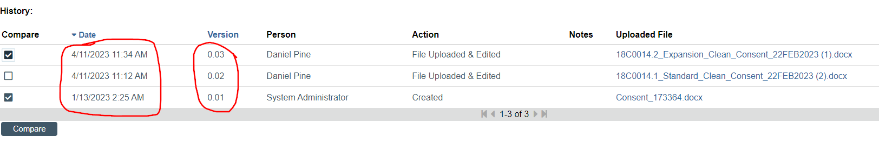
Comparing documents in PROTECT
If you are reviewing the changes and the MOD was sent back for clarifications at the pre-review or IRB review state, there may have been additional changes made to the documents through the round of clarifications. In this case you will have several versions stacked.
Pay close attention to the version dates. Make sure you compare the currently approved version with the most recent version the team has submitted to be able to see the TOTAL changes including modifications requested.

Slide 13
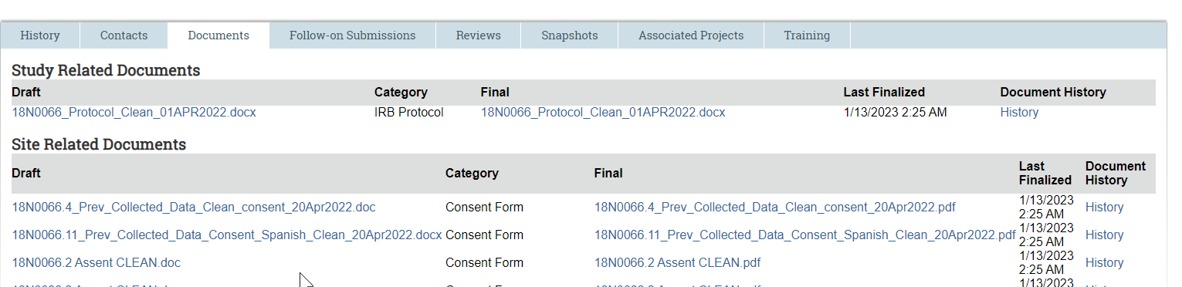
Where to find your documents
Documents will be housed in the study related and site related documents area (Protocol, consents, recruitment materials, etc.).
All documents that are in the “final” column are those that have been approved and stamped (if applicable) by the IRB.

Slide 14
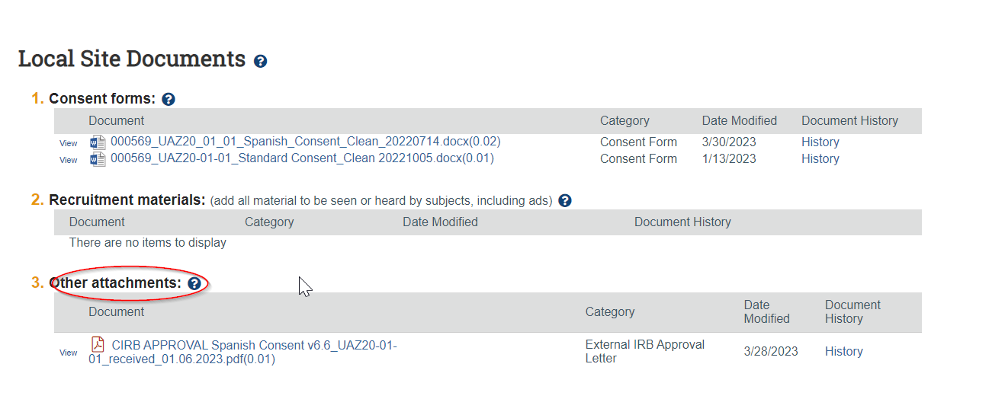
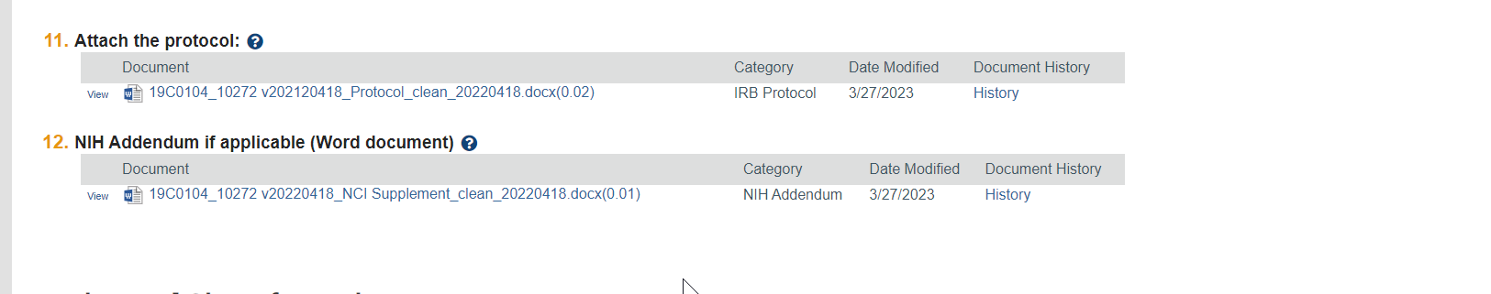
Uploading NIH addendums for Multi-site Studies
The NIH Protocol Addendum for MSS should be uploaded under number 12 on the Study Form, “NIH Addendum if applicable”.
For multi-site studies in the study form you will have two sections for documents; Study Related Documents and Local Site Documents
If your study is reviewed by an external IRB, include the External IRB letter approving the NIH site in the “Other attachments” section of Local Site Documents.

Slide 15
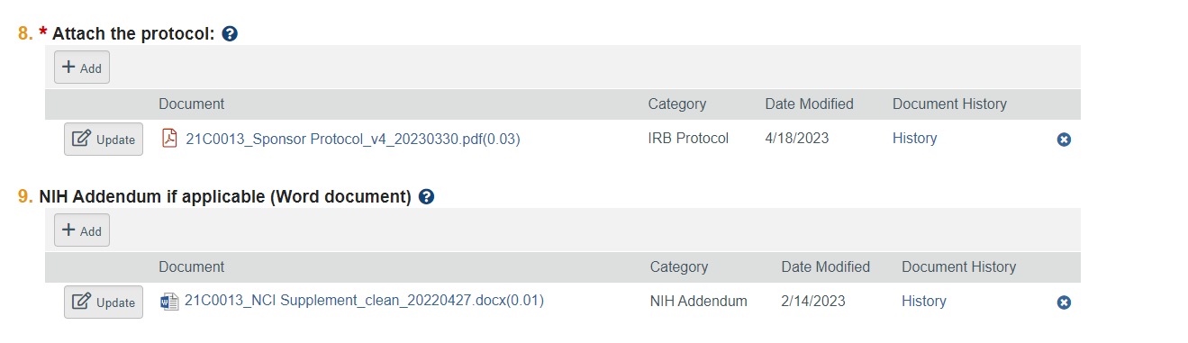
Uploading sponsor protocols
SPONSOR PROTOCOLS that only come in PDF
Upload under the BASIC Study Information Section on the Study Form
In the Protocol section a Clean Copy of the Sponsor Protocol will be added here
Tracked change versions of the Sponsor Protocol will be uploaded just beneath the clean copy of the Sponsor protocol. IRBO will not be finalizing tracked change documents.
DO NOT attach the tracked change version of the sponsor protocol in the Drug Section or Other attachments at the end of the form. This will impact document management over time.

Slide 16
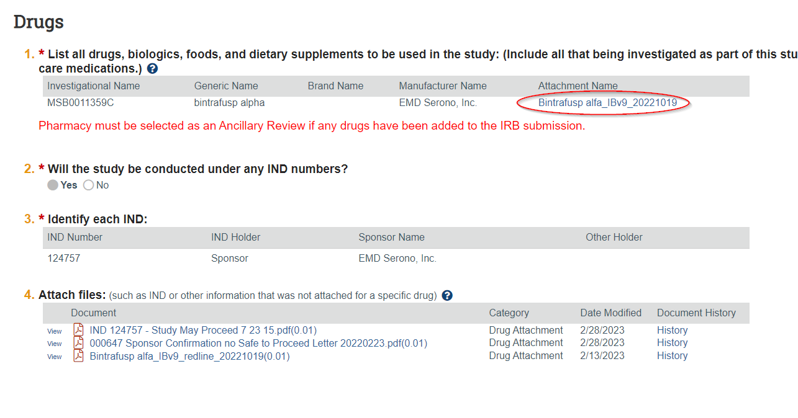
Where to upload your drug/device documents
Drug, device and FDA documentation should be uploaded in the section with the drug/device information
In the drug (or device) section of the study form, there will be an option to add a supporting document(s). You want to attach all IBs, package inserts, device labels, etc. here.

Slide 17
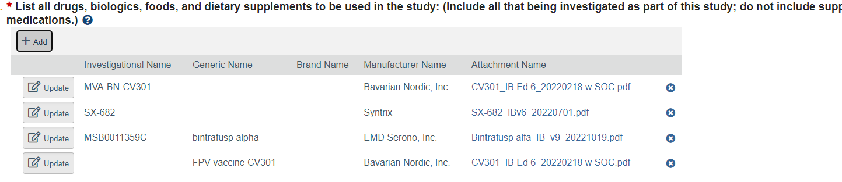
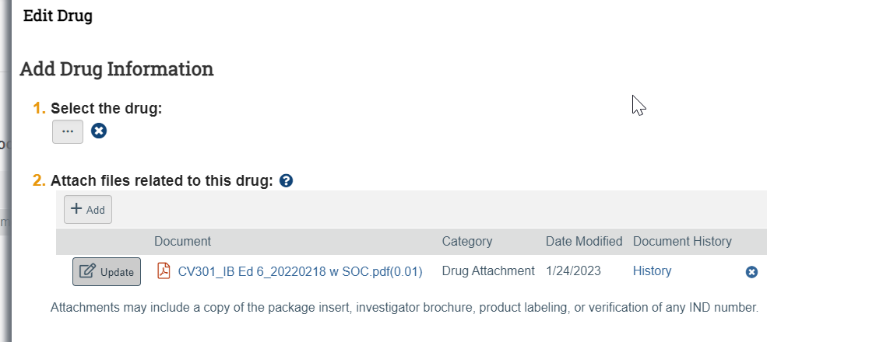
Uploading Investigator Brochures
Drug section of study form
Updating a drug and attaching an IB

Slide 18
Drug/Device documents
Upload tracked IBs under the “attach files” section of the designated drug area on the study form, if provided and relevant. You will use the same “update” feature in this section to stack subsequent drug and device information for future MODS, etc.
FDA documentation (safe to proceed letter, etc.) should be uploaded in the “attach files” section under the IND/IDE information.

Slide 19
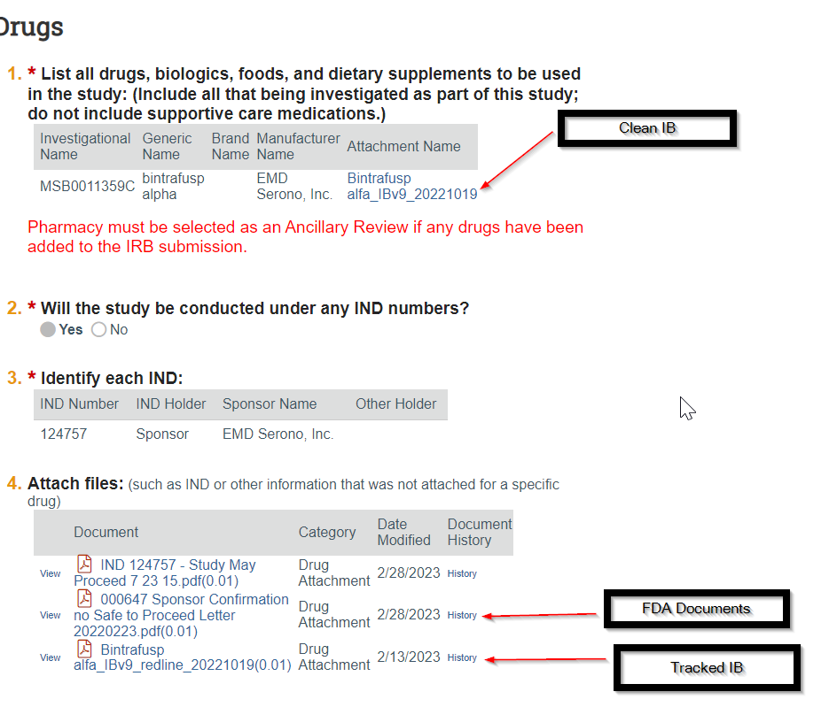
Drug/Device documents

Slide 20
Scenarios to fix stacking of documents
You see documents that were migrated from PROTECT which are not the most recently approved.
  In this case you can delete out the whole document history by using the delete “x” button next to the history.
  Upload the most recently approved document from iRIS in Word format as if you are adding a new document within your MOD form. Then use the “Update” button on that document to upload your revised document to stack it on top of the most recently approved document.

Slide 21
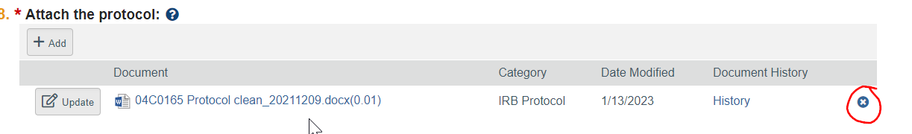
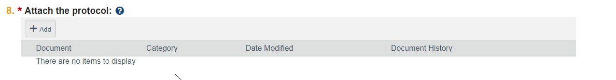
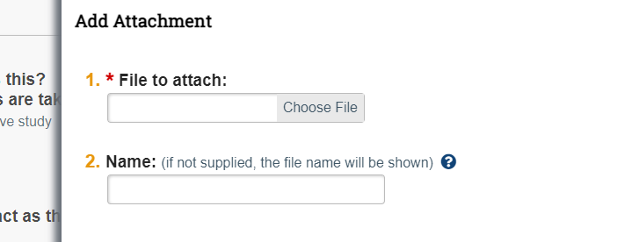
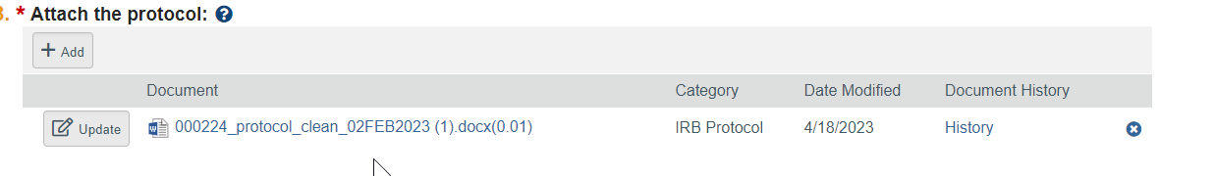
1. Use the delete function to remove the whole document history
2. Click “Add” to attach a new file

Slide 22
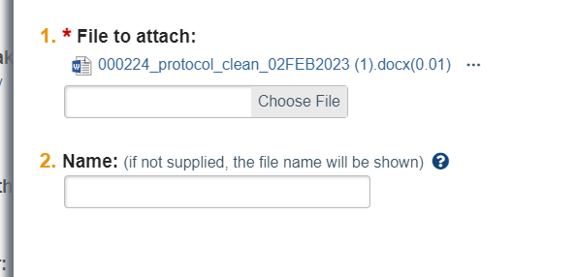
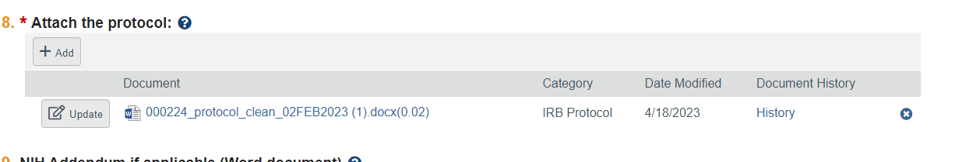
3. Click “update” to upload the new document on top
You will notice the version number increase (0.01, 0.02, etc.)

Slide 23
Scenarios to fix stacking of documents
You have stacked some incorrect documents in between the most recently approved and your revised document
  DO NOT delete out the entire document history.
  Stack the correct document on top of all the other documents
  Include a mention of the stacking issues in your response to clarifications, response to stips on in the Mod Summary Form

Slide 24
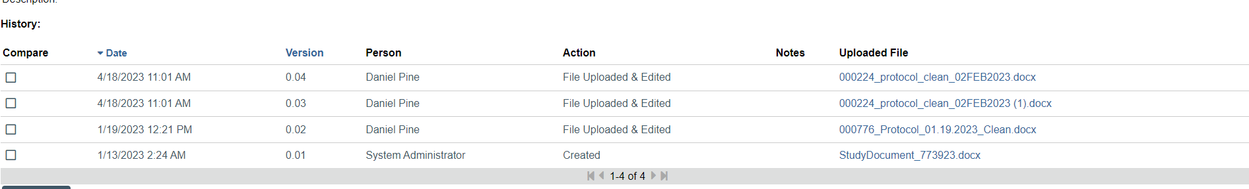
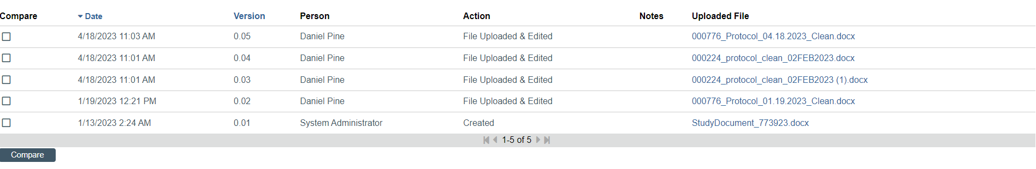
1. Stack the correct document on top of the last uploaded document

Slide 25
Document types
PROTECT will only accept certain types of documents to be uploaded.
Ensure that before uploading a document, it is in one of the following formats:
.bmp
.doc
.docx
.jpeg
.jpg
.pdf
.png
.ppt
.pptx,
.rtf,
.tif,
.tiff,
.xls,
.xlsx,
.html

Slide 26
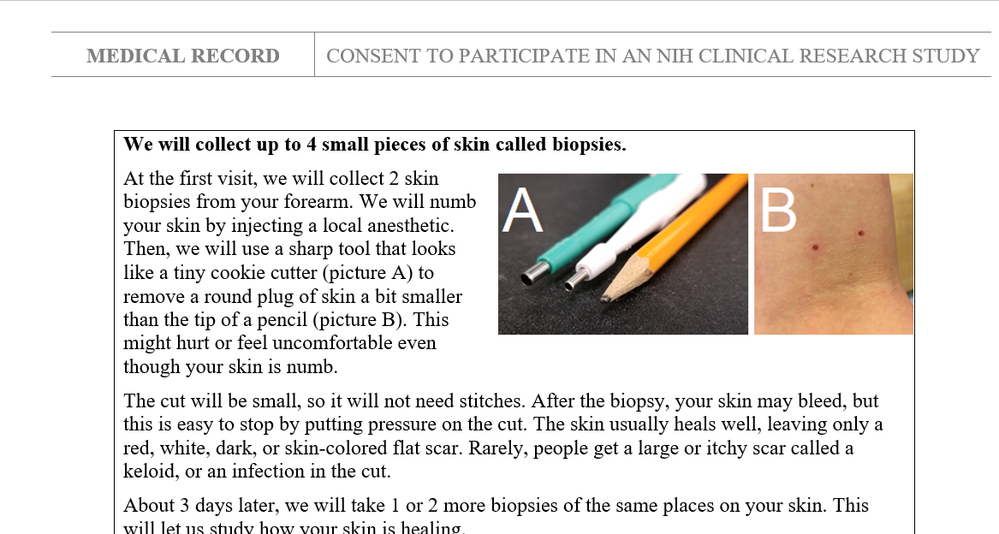
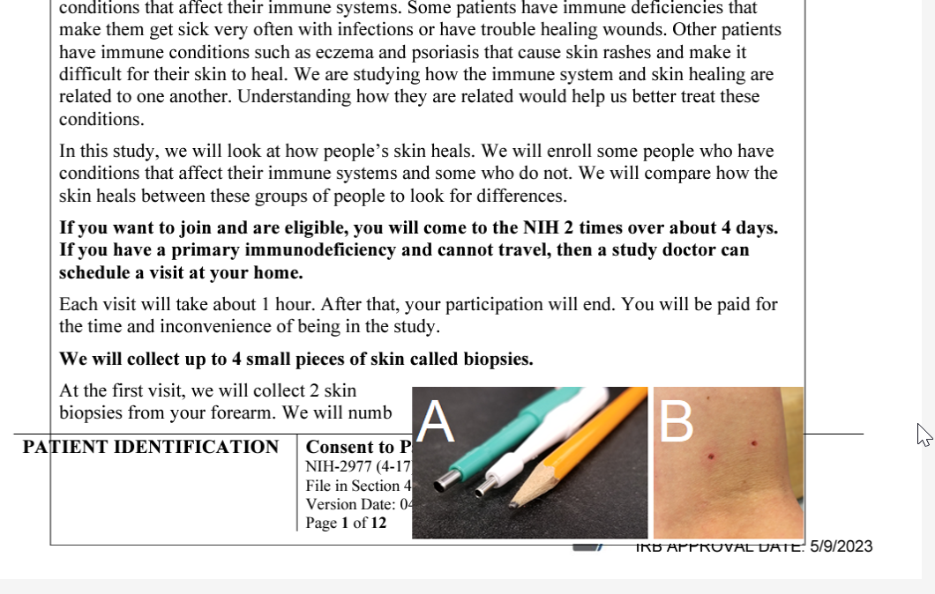
Document Types
For documents that include:
  incorrect margin or footer format
  pictures or a table
  translated language ( e.g Gujarati, Amharic);
  It is helpful to do a test conversion of the consent document to PDF on your desktop to determine if items in the consent get shifted in the conversion.
Word Document
Converted PDF

Slide 27
Naming Conventions
Protocols:
How to Name a Clean Protocol:
  IRBNumber_ProtocolClean_VersionDate(DDMMYYYY)
Example of a Correctly Named Clean Protocol:
  18M0015_ProtocolClean_14JAN2021
Consents:
How to Name a Clean Consent
  IRBNumber.OPSConsentNumber_Cohort_CleanConsent_VersionDate(DDMMYYYY)
Example of a correctly named Clean Consent
  18M0015.1_HealthyVolunteer_CleanConsent_14JAN2021
  For more examples and guidance visit the IRBO website at: https://irbo.nih.gov/confluence/display/ohsrp/How+to+Name+Your+Documents

